Slide 1
Limitations of Algorithm Power

Slide 2
Limitations
In the course of the semester, we have come across many algorithms for solving different types of problems.
But, algorithms have their own limitations.
There are problems which do not have an algorithm to solve them.
And, there are other problems which have algorithms to solve them but not in polynomial time.

Slide 3
Limitations
In this chapter, we shall study the limitations of an algorithm.

Slide 4
1.
Lower Bound Arguments

Slide 5
Lower Bound Arguments
To determine if an algorithm is practically useful or not, we need to look at its efficiency.
The efficiency of an algorithm can be determined in two ways:
Asymptotic Efficiency
Lower Bound Arguments

Slide 6
Asymptotic Efficiency
We can determine the asymptotic efficiency of an algorithm.
Example:
Selection Sort has quadratic efficiency
Towers of Hanoi has exponential efficiency
According to this comparison, selection sort has a better efficiency than Towers of Hanoi.

Slide 7
Asymptotic Efficiency
But this comparison is similar to comparing apples with oranges.
The fairer approach would be to compare the asymptotic efficiency of an algorithm with other algorithms solving the same problem.
So, according to this concept, selection sort has slower efficiency because there are sorting algorithms which have n log n efficiency.

Slide 8
Lower Bound Arguments
When trying to ascertain the practical applicability of an algorithm, it is desirable to know the best possible efficiency of an algorithm.
Knowing such a lower bound can tell us how much improvement we can hope to achieve in our quest for a better algorithm for the problem in question.
If such a bound is tight, i.e., we already know an algorithm in the same efficiency class as the lower bound, we can hope for a constant-factor improvement at best.

Slide 9
Lower Bound Arguments
If there is a gap between the efficiency of the fastest algorithm and the best lower bound known, the door for possible improvement remains open.
Either a faster algorithm matching the lower bound could exist or a better lower bound could be proved.

Slide 10
Trivial Lower Bounds
The simplest method of obtaining a lower-bound class is based on counting the number of items in the problem's input that must be processed and the number of output items that need to be produced.
Since any algorithm must at least "read“ all the items it needs to process and "write" all its outputs, such a count yields a trivial lower bound.

Slide 11
Trivial Lower Bounds - Examples
Generating Permutations – Ω(n!)
Polynomial Evaluation – Ω(n)
Matrix Multiplication – Ω(n²)
Travelling Salesman Problem - Ω(n²)

Slide 12
Trivial Lower Bounds - Problems
They are sometimes too low to be useful.
It assumes that every element of input needs to be processed to solve the problem, which is not the case.
For example, in searching problem, we need not check every element of the input.

Slide 13
Adversary Arguments – Example 1
Consider a game of guessing a number between 1 to n selected by somebody by asking that person yes / no questions.
The minimum number of questions that need to be asked to solve this problem is floor(log₂n).
The adversary starts by considering each of the numbers between 1 and n as being potentially selected.

Slide 14
Adversary Arguments – Example 1
After each question, the adversary gives an answer that leaves him with the largest set of numbers consistent with this and all the previously given answers. (This strategy leaves him with at least one half of the numbers he had before his last answer.)
If an algorithm stops before the size of the set is reduced to one, the adversary can exhibit a number that could be a legitimate input the algorithm failed to identify.

Slide 15
Adversary Arguments – Example 1
It is a simple technical matter now to show that one needs floor(log₂n) iterations to shrink an n-element set to a one-element set by halving and rounding up the size of the remaining set.
Hence, at least log₂n questions need to be asked by any algorithm in the worst case.

Slide 16
Adversary Arguments – Example 1
It is a simple technical matter now to show that one needs floor(log₂n) iterations to shrink an n-element set to a one-element set by halving and rounding up the size of the remaining set.
Hence, at least log₂n questions need to be asked by any algorithm in the worst case.

Slide 17
Adversary Arguments
Based on following the logic of a malevolent but honest adversary.
The malevolence makes him push the algorithm down the most time-consuming path.
While his honesty forces him to stay consistent with the choices already made.
A lower bound is then obtained by measuring the amount of work needed to shrink a set of potential inputs to a single input along the most time-consuming path.

Slide 18
Adversary Arguments – Example 2
Consider the problem of merging two sorted lists of size n:
a₁ < a₂ < ... < a_{n} and b₁ < b₂ < ... < b_{n}
into a single sorted list of size 2n.
For simplicity, we assume that all the a's and b's are distinct, which gives the problem a unique solution.

Slide 19
Adversary Arguments – Example 2
The adversary will employ the following rule: reply true to the comparison a_{i}< b_{j} if and only if i < j.
This will force any correct merging algorithm to produce the only combined list consistent with this rule:
b₁ < a₁ < b₂ < a₂ < …. < b_{n} < a_{n}

Slide 20
Adversary Arguments – Example 2
To produce this combined list, any correct algorithm will have to explicitly compare 2n - 1 adjacent pairs of its elements, i.e., b1 to a1, a1 to b2, and so on.
If one of these comparisons has not been made, e.g., a1, has not been compared to b2, we can transpose these keys to get
b₁ < b₂ < a₁ < a₂ < …. < b_{n} < a_{n}

Slide 21
Adversary Arguments – Example 2
Hence, 2n - 1 is indeed a lower bound for the number of key comparison needed for any merging algorithm.

Slide 22
Problem Reduction
To show that problem P is at least as hard as another problem Q with a known lower bound, we need to reduce Q to P (not P to Q!).
In other words, we should show that an arbitrary instance of problem Q can be transformed (in a reasonably efficient fashion) to an instance of problem P, so any algorithm solving P would solve Q as well. Then a lower bound for Q will be a lower bound for P.

Slide 23
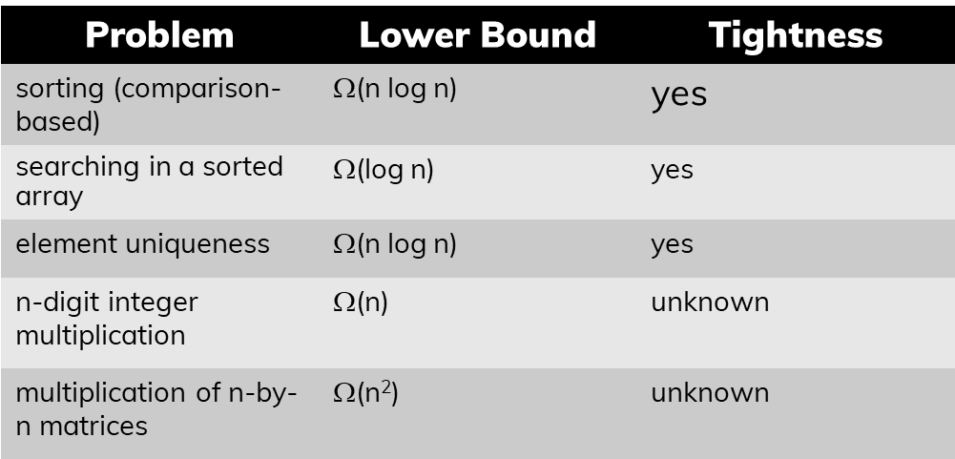
Important Problems used for Problem Reduction

Slide 24
Problem Reduction - Example
Consider the Euclidean minimum spanning tree problem: given n points in the Cartesian plane, construct a tree of minimum total length whose vertices are the given points.

Slide 25
Problem Reduction - Example
As a problem with a known lower bound, we use the element uniqueness problem.
We can transform any set x₁, x₂, ... , x_{n} of n real numbers into a set of n points in the Cartesian plane by simply adding 0 as the points' y coordinate: (x₁, 0), (x₂, 0), ... , (x_{n},0).

Slide 26
Problem Reduction - Example
Let T be a minimum spanning tree found for this set of points.
Since T must contain a shortest edge, checking whether T contains a zero length edge will answer the question about uniqueness of the given numbers.
This reduction implies that Ω (n log n) is a lower bound for the Euclidean minimum spanning tree problem, too.

Slide 27

Problem Reduction - Example
The final results about the complexity of many problems are not known and hence the reduction technique is often used to compare the relative complexity of problems.
The following formulae show that the problems of computing the product of two n-digit integers and squaring an n-digit integer belong to the same complexity class.

Slide 28
Problem Reduction - Example
Multiplying two symmetric matrices turns out to be in the same complexity class as multiplying two arbitrary square matrices.
The former problem is a special case of the latter one, but we also can reduce the problem of multiplying two arbitrary square matrices of order n, say A and B, to the problem of multiplying two symmetric matrices.

Slide 29


Problem Reduction - Example

Slide 30
2.
Decision Trees

Slide 31
Introduction
Many important algorithms, especially those for sorting and searching, work by comparing items of their inputs.
We can study the performance of such algorithms with a device called the decision tree.

Slide 32
Introduction
Many important algorithms, especially those for sorting and searching, work by comparing items of their inputs.
We can study the performance of such algorithms with a device called the decision tree.

Slide 33
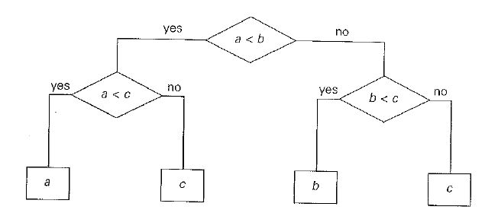
Decision Tree for finding a minimum of three numbers

Slide 34

Idea
The central idea behind this model lies in the observation that a tree with a given number of leaves, which is dictated by the number of possible outcomes, has to be tall enough to have that many leaves.
Specifically, it is not difficult to prove that for any binary tree with leaves and height h,

Slide 35
Idea
A binary tree of height h with the largest number of leaves has all its leaves on the last level.
Hence, the largest number of leaves in such a tree is 2^{h}.
In other words, 2^{h} >= I which implies:

Slide 36
Decision Trees for Sorting Algorithms
Most sorting algorithms are comparison-based, i.e., they work by comparing elements in a list to be sorted.
By studying properties of binary decision trees, for comparison-based sorting algorithms, we can derive important lower bounds on time efficiencies of such algorithms.

Slide 37
Decision Trees for Sorting Algorithms
We can interpret an outcome of a sorting algorithm as finding a permutation of the element indices of an input list that puts the list's elements in ascending order.
For example, for the outcome a < c < b obtained by sorting a list a, b, c.
The number of possible outcomes for sorting an arbitrary n-element list is equal to n!.

Slide 38

Decision Trees for Sorting Algorithms
The height of a binary decision tree for any comparison-based sorting algorithm and hence the worst -case number of comparisons made by such an algorithm cannot be less than:

Slide 39
Decision Trees for Sorting Algorithms
Using Stirling’s formula:
About n log₂n comparisons are necessary to sort an arbitrary n-element list by any comparison-based sorting algorithm.

Slide 40
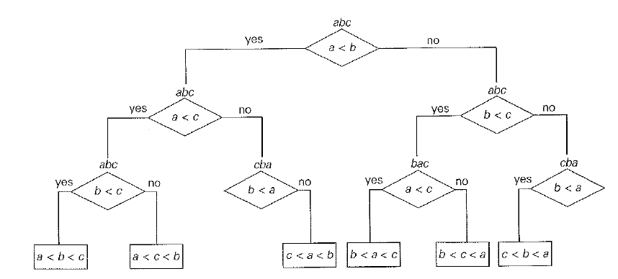
Decision Tree - Three Element Selection Sort

Slide 41
Decision Trees for Sorting Algorithms
We can also use decision trees for analyzing the average-case behavior of a comparison based sorting algorithm.
We can compute the average number of comparisons for a particular algorithm as the average depth of its decision tree's leaves, i.e., as the average path length from the root to the leaves.

Slide 42
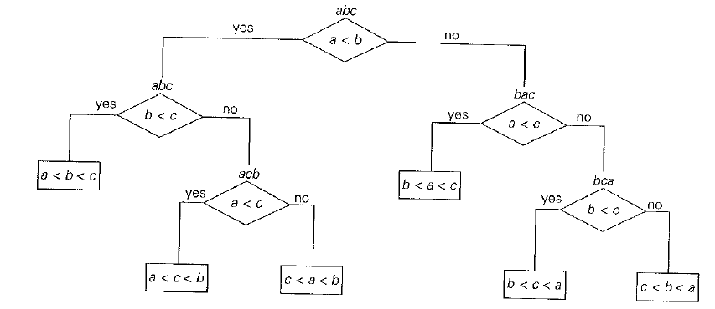
Decision Trees for Sorting Algorithms

Slide 43
Decision Trees for Sorting Algorithms
For example, for the three-element insertion sort this number is:
(2 + 3 + 3 + 2 + 3 + 3)/6 = 2(2/3).

Slide 44

Decision Trees for Sorting Algorithms
Under the standard assumption that all n! outcomes of sorting are equally likely, the following lower bound on the average number of comparisons C_{avg} made by any comparison-based algorithm in sorting an n-element list has been proved:

Slide 45

Decision Trees for Searching Algorithms
Decision trees can be used for establishing lower bounds on the number of key comparisons in searching a sorted array of n keys: A[O] < A[1] < ... < A[n -1].
The number of comparisons made by binary search in the worst case:

Slide 46
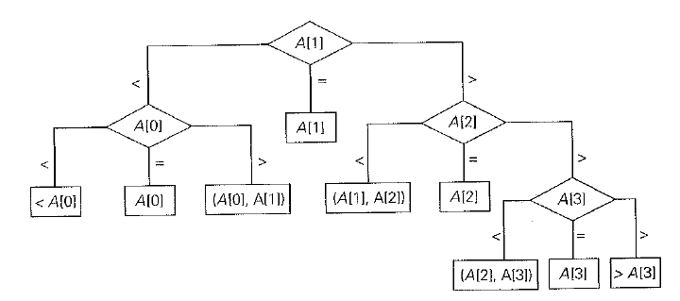
Decision Trees for Searching Algorithms

Slide 47

Decision Trees for Searching Algorithms
For an array of n elements, all such decision trees will have 2n +1 leaves (n for successful searches and n + 1 for unsuccessful ones).
Since the minimum height h of a ternary tree with l leaves is floor(log₃l), we get the following lower bound on the number of worst-case comparisons:

Slide 48
Decision Trees for Searching Algorithms
This lower bound is smaller than ceil(log₂(n + 1)), the number of worst-case comparisons for binary search, at least for large values of n (and smaller than or equal to ceil(log₂(n + 1)) for every positive integer.
Can we prove a better lower bound, or is binary search far from being optimal?

Slide 49
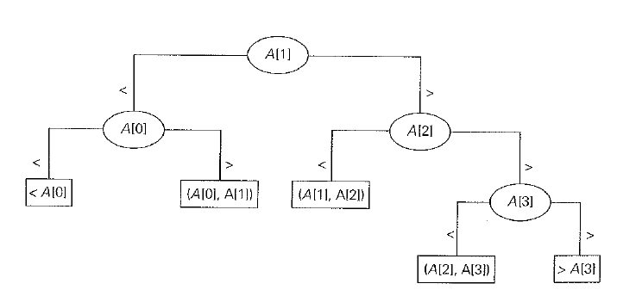
Decision Trees for Searching Algorithms

Slide 50

Decision Trees for Searching Algorithms

Slide 51
3.
P, NP and NP Complete Problems

Slide 52
DEFINITION 1 Polynomial Time Algorithms
We say that an algorithm solves a problem in polynomial time if its worst-case time efficiency belongs to O(p(n)) where p(n) is a polynomial of the problem's input size n.
Note: Since, we are using big · oh notation here, problems solvable in, say logarithmic time are solvable in polynomial time as well.

Slide 53
Tractable and Intractable Problems
Problems that can be solved in polynomial time are called tractable.
problems that cannot be solved in polynomial time are called intractable.

Slide 54
Why are problems that cannot be solved in polynomial time intractable?
We cannot solve arbitrary instances of such problems in a reasonable amount of time.
There are very few useful polynomial-time algorithms with the degree of a polynomial higher than three and do not usually involve extremely large coefficients.

Slide 55
Why are problems that cannot be solved in polynomial time intractable?
Third, polynomial functions possess many convenient properties; in particular, both the sum and composition of two polynomials are always polynomials too.
Fourth, the choice of this class has led to a development of an extensive theory called computational complexity, which seeks to classify problems according to their inherent difficulty.

Slide 56
DEFINITION 1 Class P
Class P is a class of decision problems that can be solved in polynomial time by (deterministic) algorithms. This class of problems is called polynomial..

Slide 57
The Restriction of P to Decision Problems
First, it is sensible to exclude problems not solvable in polynomial time because of their exponentially large output.
Second, many important problems that are not decision problems in their most natural formulation can be reduced to a series of decision problems that are easier to study.

Slide 58
Undecidable Problems
Some decision problems cannot be solved at all by any algorithm. Such problems are called undecidable.
Example: Halting Problem given by Alan Turing in 1936.

Slide 59
Halting Problem
Given a computer program and an input to it, determine whether the program will halt on that input or continue working indefinitely on it.

Slide 60

Proof
By way of contradiction, assume that A is an algorithm that solves the halting problem. That is, for any program P and input I,
We can consider program P as an input to itself and use the output of algorithm A for pair (P, P) to construct a program Q as follows:

Slide 61


Proof
Then, on substituting Q for P, we obtain:

Slide 62
Best known problems with no polynomial – time algorithm
Hamiltonian Circuit
Traveling Salesman
Knapsack Problem
Partition Problem
Bin Packing
Graph Coloring
Integer Linear Programming

Slide 63
DEFINITION Non – Deterministic Algorithm
A nondeterministic algorithm is a two-stage procedure that takes as its input an instance I of a decision problem and does the following:
Nondeterministic ("guessing") stage: An arbitrary string S is generated that can be thought of as a candidate solution to the given instance I
Deterministic ("verification") stage: A deterministic algorithm takes both I and S as its input and outputs yes if S represents a solution to instance I.

Slide 64
DEFINITION Non – Deterministic Polynomial
A nondeterministic algorithm is said to be nondeterministic polynomial if the time efficiency of its verification stage is polynomial

Slide 65
DEFINITION Class NP
Class NP is the class of decision problems that can be solved by nondeterministic polynomial algorithms. This class of problems is called nondeterministic polynomial.

Slide 66
DEFINITION Class NP
Class NP is the class of decision problems that can be solved by nondeterministic polynomial algorithms. This class of problems is called nondeterministic polynomial.

Slide 67

Class NP
Most decision problems are in NP. First of all, this class includes all the problems in P:

Slide 68
DEFINITION Class NP
If a problem is in P, we can use the deterministic polynomial time algorithm that solves it in the verification-stage of a nondeterministic algorithm that simply ignores string S generated in its nondeterministic ("guessing") stage.

Slide 69
DEFINITION Class NP
But NP also contains the Hamiltonian circuit problem, the partition problem, as well as decision versions of the traveling salesman, the knapsack, graph coloring and many hundreds of other difficult combinatorial optimization problems.
The halting problem, on the other hand, is among the rare examples of decision problems that are known not to be in NP.

Slide 70

QUESTION
This leads to the most important open question of theoretical computer science:
“Is P a proper subset of NP, or are these two classes, in fact, the same?
We can put this symbolically as

Slide 71
POLYNOMIAL TIME REDUCIBILITY
A decision problem D₁ is said to be polynomially reducible to a decision problem D₂ if there exists a function t that transforms instances of D₁ to instances of D₂ such that:
t maps all yes instances of D₁ to yes instances of D₂ and all no instances of D1 to no instances of D2
t is computable by a polynomial-time algorithm.

Slide 72
NP COMPLETE PROBLEM
A decision problem D is said to be NP-complete if:
It belongs to class NP
Every problem in NP is polynomially reducible to D

Slide 73
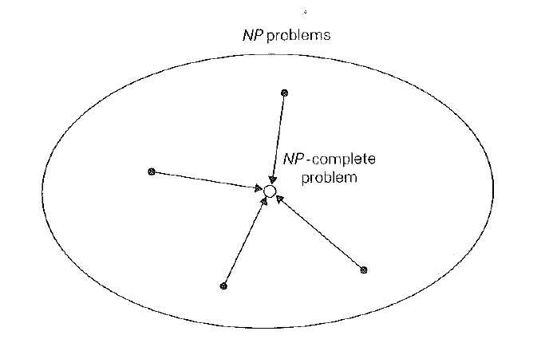
NP COMPLETE PROBLEM

Slide 74
NP COMPLETE PROBLEM
Let us prove that the Hamiltonian circuit problem is polynomially reducible to the decision version of the traveling salesman problem.
The latter can be stated as the problem to determine whether there exists a Hamiltonian circuit in a given complete graph with positive integer weights whose length is not greater than a given positive integer m.

Slide 75
NP COMPLETE PROBLEM
We can map a graph G of a given instance of the Hamiltonian circuit problem to a complete weighted graph G' representing an instance of the traveling salesman problem by assigning 1 as the weight to each edge in G and adding an edge of weight 2 between any pair of nonadjacent vertices in G.
As the upper bound m on the Hamiltonian circuit length, we take m = n, where n is the number of vertices in G (and G').
Obviously, this transformation can be done in polynomial time.

Slide 76
NP COMPLETE PROBLEM
Let G be a yes instance of the Hamiltonian circuit problem.
Then G has a Hamiltonian circuit, and its image in G' will have length n, making the image a yes instance of the decision traveling salesman problem.

Slide 77
NP COMPLETE PROBLEM
Conversely, if we have a Hamiltonian circuit of the length not larger than n in G', then its length must be exactly n and hence the circuit must be made up of edges present in G, making the inverse image of the yes instance of the decision traveling salesman problem be a yes instance of the Hamiltonian circuit problem.
This completes the proof.

Slide 78

CNF SATISFIABILITY PROBLEM
The CNF-satisfiability problem deals with boolean expressions.
Each boolean expression can be represented in conjunctive normal form, such as the following expression:

Slide 79
CNF SATISFIABILITY PROBLEM
The CNF-satisfiability problem asks whether or not we can assign values true and false to variables of a given boolean expression in its CNF form to make the entire expression true.
It is easy to see that this can be done for the above formula: if x₁ = true, x₂ = true, and x₃ = false, the entire expression is true.

Slide 80
NP – COMPLETE PROBLEMS
Showing that a decision problem is NP-complete can be done in two steps.
First, one needs to show that the problem in question is in NP; i.e., a randomly generated string can be checked in polynomial time to determine whether or not it represents a solution to the problem. Typically, this step is easy.

Slide 81
NP – COMPLETE PROBLEMS
The second step is to show that every problem in NP is reducible to the problem in question in polynomial time.
Because of the transitivity of polynomial reduction, this step can be done by showing that a known NP-complete problem can be transformed to the problem in question in polynomial time.

Slide 82
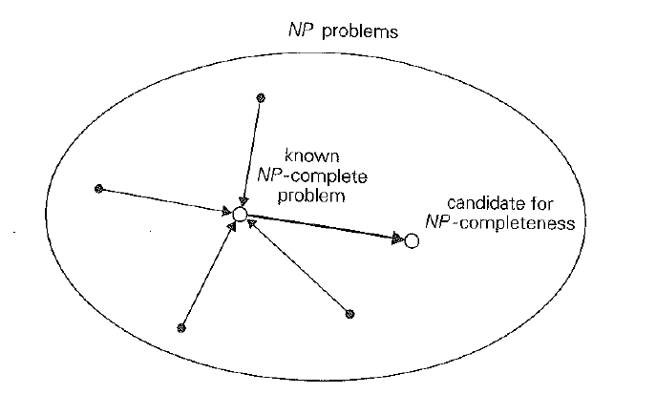
NP – COMPLETE PROBLEMS

Slide 83
NP – COMPLETE PROBLEMS
The definition of NP-completeness immediately implies that if there exists a deterministic polynomial-time algorithm for just one NP-complete problem, then every problem in N P can be solved in polynomial time by a deterministic algorithm, and hence P = NP.
Such implications make most computer scientists believe that P is not equal to NP, although nobody has been successful so far in finding a mathematical proof of this intriguing conjecture.

